Slide 1



Housing Price Prediction
Guided By:
Shubham Yadav
Presented By:
Gokula Krishnan R

Slide 2
ABSTRACT
House prices increase every year, so there is a need for a system to predict house prices in the future. House price prediction can help the developer determine the selling price of a house and can help the customer to arrange the right time to purchase a house.
Houses are one of the necessary need of each and every person around the globe and therefore housing and real estate market is one of the markets which is one of the major contributors in the world’s economy.
The goal of this statistical analysis is to help us understand the relationship between house features and how these variables are used to predict house price.

Slide 3
EXPERIMENTAL SET UP
Hardware requirements:-
1. Processor — core i5 and above
2. RAM — 8 GB or above
3. SSD— 250 GB or above
Software requirements:-
1. ANACONDA

Slide 4
INTRODUCTION
From the dataset get to know that it is a Regression problem and Sale Price of house varies on its properties and there are so many features which help to find it.
In this case, Sale Price varies on its properties, and we are going to use many Regression techniques.

Slide 5
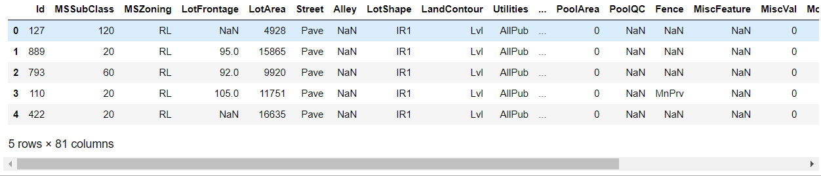
DATA PREPRATION
With the help of Pandas Library, We will upload our data to Jupyter Notebook.
Once our data is uploaded with the help of predefined method (i.e. read_csv) we can read data for further processing.
We have two type of variables in the data:-
Dependent Variable
Independent Variable

Slide 6
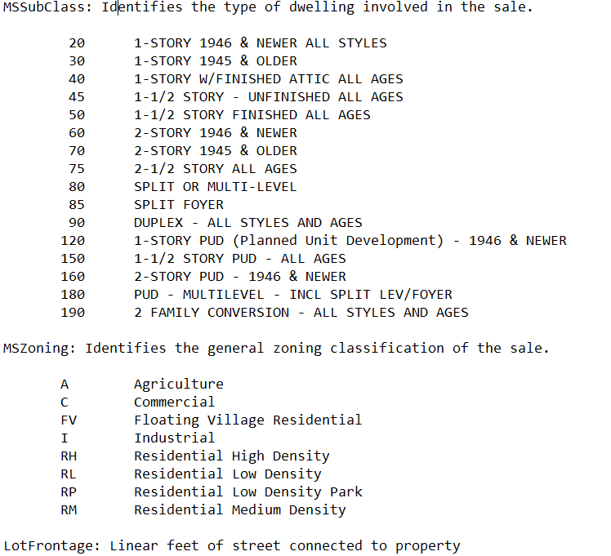
Sales price is an independent variable whereas all of the other element are dependent variable.

Slide 7
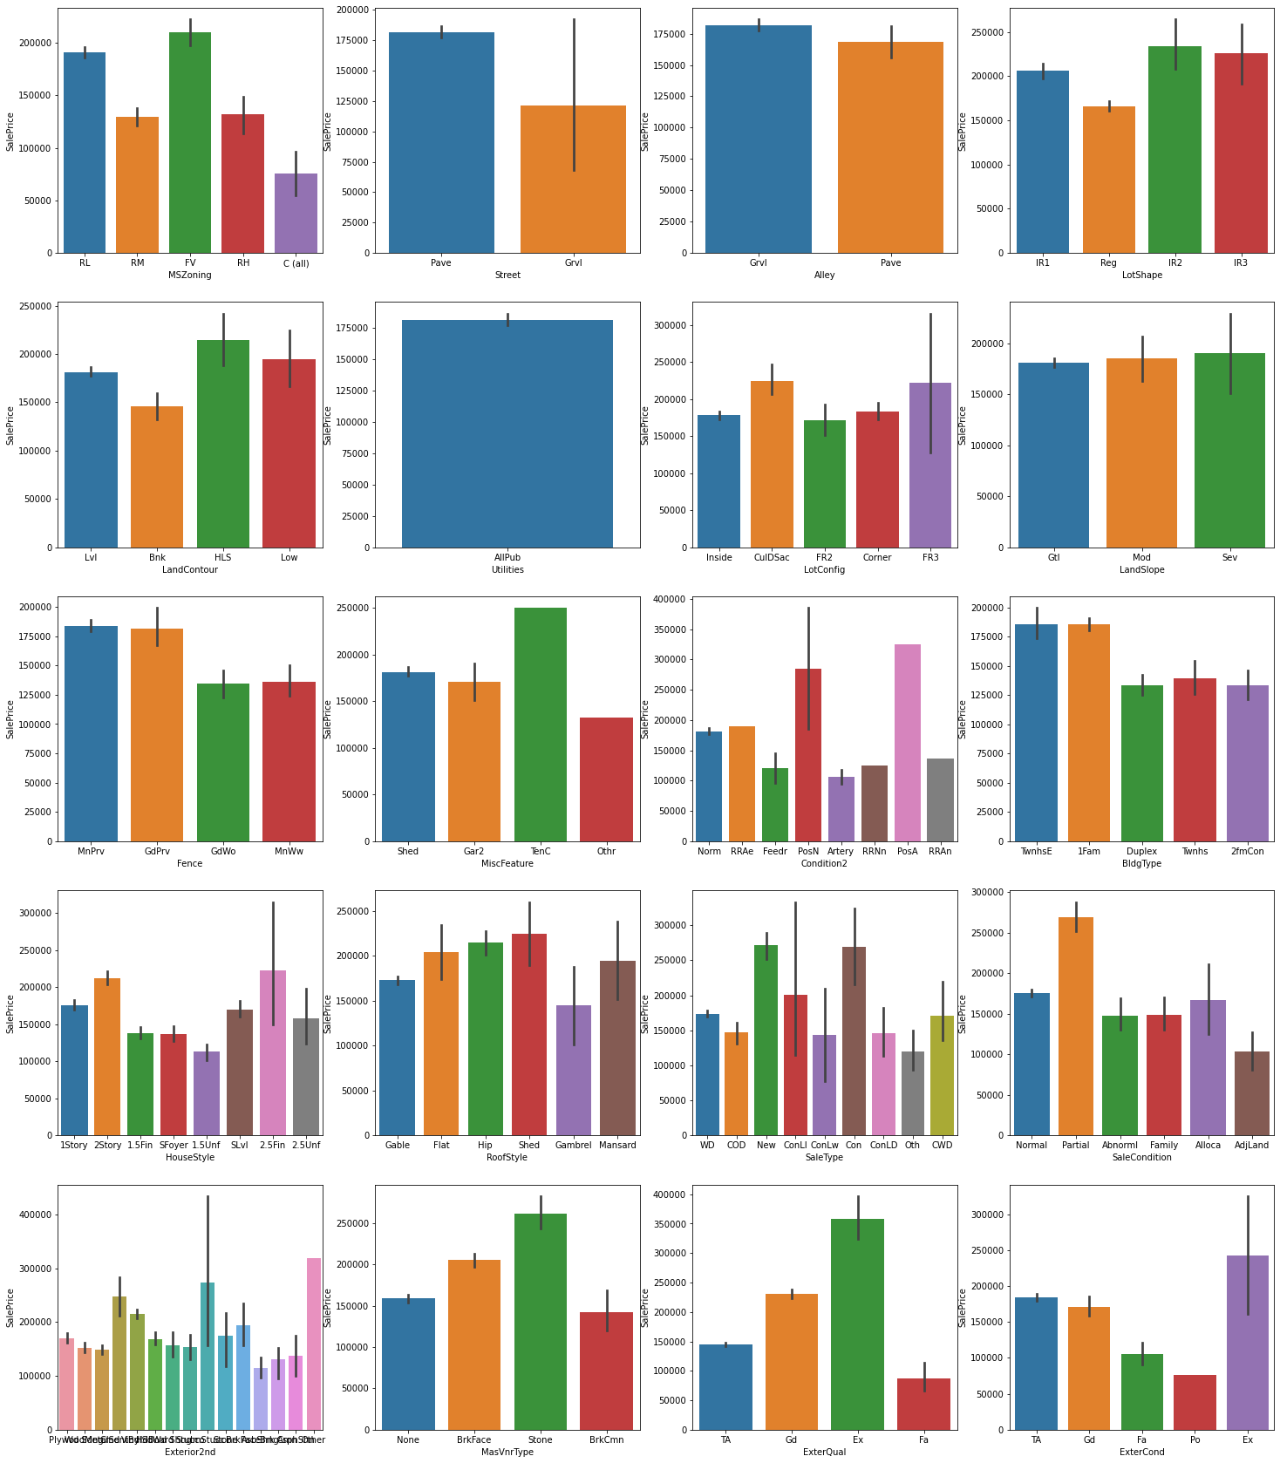

Slide 8
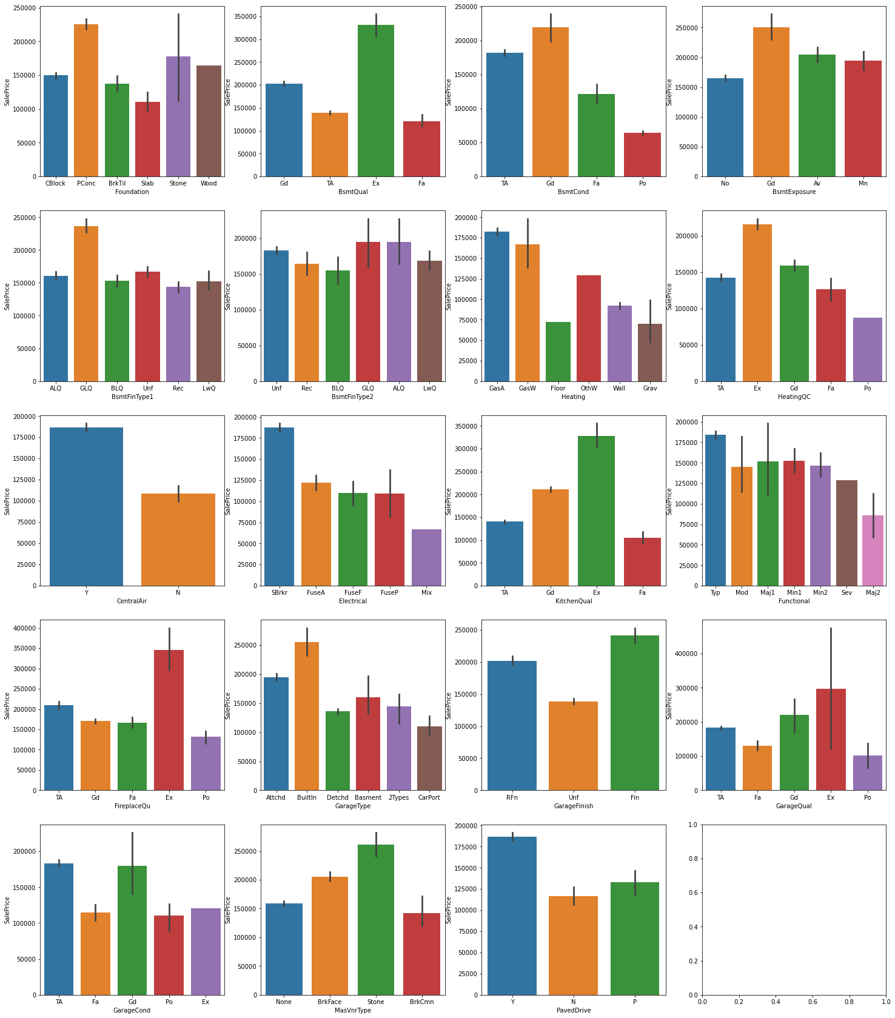

Slide 9
Observation:
Floating Village Residential, Residential Low Density has high sales price and commercial buildings has less price
Properties with paved streets has high sales prices compared to gravel roads.
Properties with paved alleys has high sales prices.
Regular shaped properties have less price moderately irregular properties have high prices
Hill side properties has high sales price
The data we collected every building has all the utilities.
Properties with Cul-de-sac kind of lot configuration has high sale price
Properties with moderate to severe slope has high sale prices
Properties in Northridge, Northridge Heights, Stone Brook locations tops in sales prices
Properties within With-in 200' of North-South Railroad has highest price followed by properties with Adjacency to positive off-site feature
Townhouse Inside Unit, Single-family Detached type of properties has high sale prices
Two and one-half story properties with 2nd level finished has high sale prices followed by 2 story buildings
Properties with shed type of roofs has high sale prices followed by hip and flat roofs.
Properties which just got constructed has high sale prices and properties with 15% Contract Down payment regular terms have also high sale prices.
Homes that are partially constructed during last assessment has high sale prices.
Properties with stone type of Masonry veneers has high prices.
Properties with excellent exterior material quality and excellent exterior condition has higher sale prices.
Properties with poured concrete type of foundation has high sale prices.
Properties with basement height of 100+ inches have high sale price
Properties with good basement condition has higher sale price whereas properties with poor basement condition has low price
Properties with good exposure to walkout or garden level walls has high sales price
Properties with Good Living Quarters has high sales prices
Properties with Gas forced warm air furnace and Gas hot water or steam heat has high sale prices.
Properties with excellent heating conditions tend to have high prices
Properties with central air conditioning has high sales prices.
Properties with Standard Circuit Breakers & Romex has high sales values
Properties with excellent kitchen quality has high price.
Typical functioning homes has high sale price.
Properties with excellent fireplace quality has high price.
Properties with built in garages has high sales price followed by attached garages. Properties which do not have any garage has less sales price
If the interior of garage is completely finished, those properties have high sale price
Properties with garages in good condition with excellent quality has high sale prices.
Properties with paved drive ways has high sales prices.
Properties with excellent pool quality has high prices
Properties with 2-STORY built in 1946 or NEWER has high sales prices.

Slide 10
DATA PREPROCESSING
The Complete data is divided in the ration of 70:30 for train and test respectively.
There is lots of null values present in the dataset and there are some outliers present in the dataset which has been removed with the help of medium of the columns and Z score.
Once our data is ready categorical variables are converted into the numeric form, which we can apply further on algorithms.
I have dropped the some column since there is no correlation between output variable and with those columns.

Slide 11
EVALUTION PROCESS
R2 Score:
Adjusted R2 Score deals with additional independent variables.
This R squared value of the r-square if our choice of independent variable wasn’t good (i.e. independent variable had no effect on dependent variable)
Also the bias of R Square to not decrease is handled pretty well in this adjusted R Squared method.
Cross Validations:
K Fold cross validations , K = 5

Slide 12
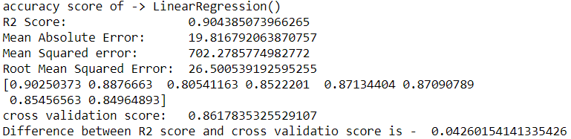
Linear Regression

Slide 13
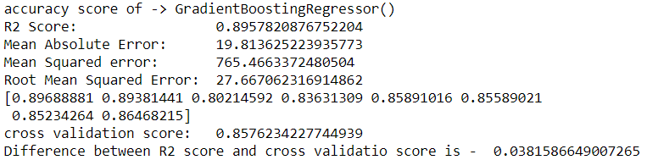
Gradient Boosting Regressor

Slide 14
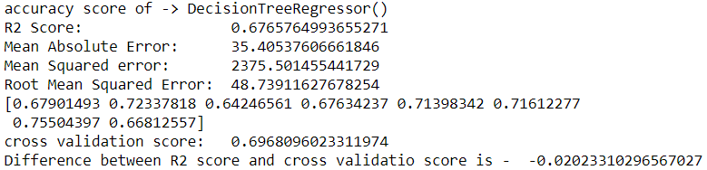
Decision Tree Regressor

Slide 15
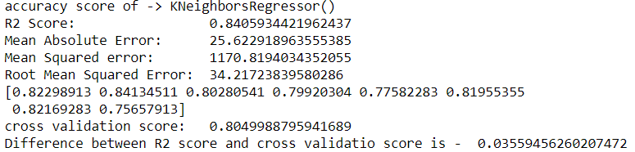
K Neighbors Regressor

Slide 16
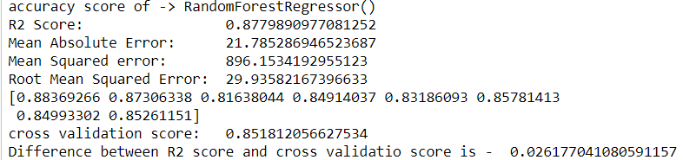
Random Forest Regressor

Slide 17
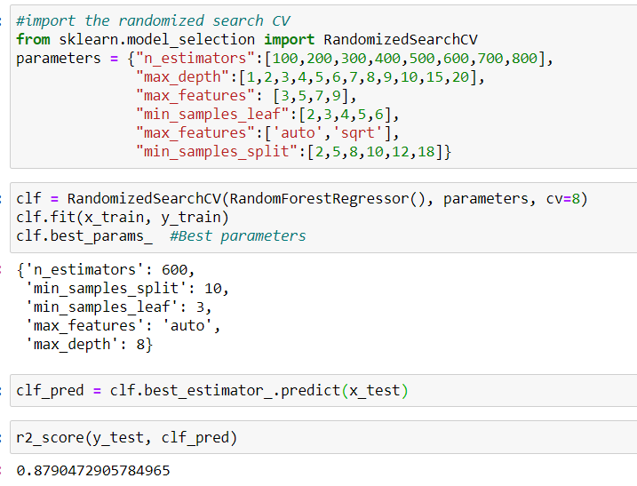
RESULT
From the details on the above solutions it is clearly understandable that we are getting best result with the help of Random Forest Regressor so we save this model with the help of joblib Library.

Slide 18
CONCLUSION
From this dataset I get to know that each feature plays a very import role to understand the data. Data format plays a very important role in the visualization and Appling the models and algorithms.
The power of visualization is helpful for the understanding of data into the graphical representation its help me to understand that what data is trying to say, Data cleaning is one of the most important steps to remove missing value or null value fill it by mean median or by mode or by 0.
Various algorithms I used in this dataset and to get out best result and save that model. The best algorithm is Random Forest Regressor.

Slide 19
FUTURE WORK
Limitations of this project is, it has lots of outliers. If we try to fix outliers by some technique the accuracy goes down. If we dope the outliers than we are everything.
In future, if someone do the proper and detail study of this dataset’s each column than we will not loss much amount of data and the accuracy will be so high.

Slide 20

Thank you

